Slide 1

Business and Domain Modeling
Notes:
1

Slide 2
Business and Domain Modeling
Understand the problem’s broader context
Business Modeling
A lack of understanding the business and its goals increases risk.
Does the problem have an organization/process component?
Does the team understand the domain in which the problem exists?
Does solving the problem present the opportunity to make process improvements?
Domain
Understand more about the application’s domain
If your business is about creating solutions within a given application space, then it is worthwhile to create a base set of application-independent abstractions of that space

Slide 3

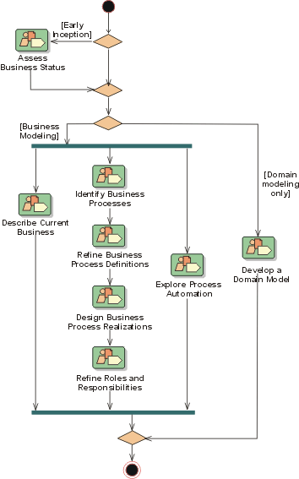
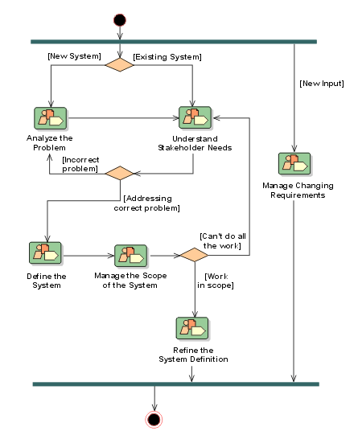


Business Modeling and Requirements
The connection between disciplines.
Business Modeling
Requirements

Slide 4
Business Modeling
The Eriksson & Penker approach:
“Business Views”
Business Vision – depict the company’s goals
Business Process – the activities of the company and the value the activities produce
Business Structure – anything structural, such as the organizational model, the product line roadmap, …
Business Behavior – looks into each of the Business Process participants in more detail (finer granularity)
- These authors also use UML, including use cases, but use a broader range of models to capture the info

Slide 5
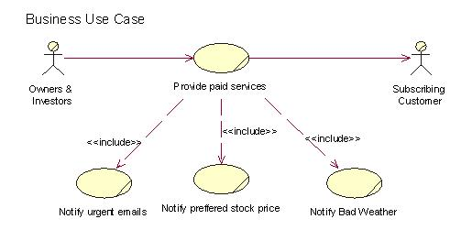
Business Modeling - Jacobsen
The Jacobsen (of RUP fame) approach:
The “business use case”
Identifies key business functions
Identifies key actors (participants) in those functions
A business object model is used to model key structures in the business
E.g. departments, paychecks, systems
Use the full power of UML here (class, component, activity diagrams)

Slide 6

Domain Modeling
Capture a Common Vocabulary
Define terms used in the project.
Help prevent misunderstandings.
Start as soon as possible.
Use throughout the project – remember you are responsible for learning the customer’s language, not the other way around!
Create an Object model, a Data Dictionary or a Data model
Define data elements with templated descriptive text.
Perhaps use a visual model to describe data relationships.
Object-orientation comes in if also considering the behavior of the objects in the domain (encapsulated data + behavior = state)
Domain objects form a vocabulary independent of control objects
A newer approach is to create an ontology, or formal taxonomic representation concepts in the domain
More informal approaches might include a Mind Map
Glossary

Slide 7
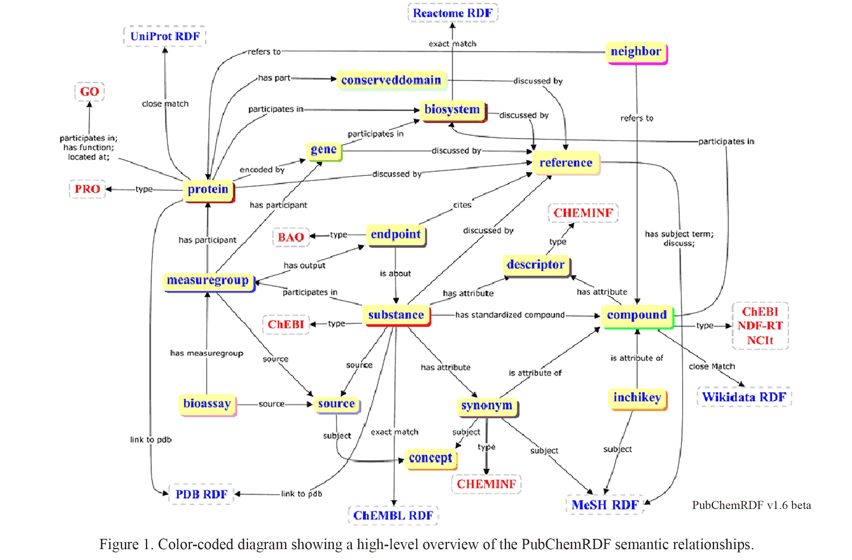
Example: PubChemRDF Ontology (NIH 2014)

Slide 8
Two More Examples: Class Diagram and an E-R Model
Trade Customer
1..2
1..*
Trading Acct.
1
*
Transaction
Market transaction
Limit Transaction
Transfer
(0,n)
Teach
(1,n)
Faculty
Student
TaxID
Name
rank
unit
email
ASUID
Name
Year
Degree
email
Fname
Lname
Fname
Lname

Slide 9
Summary
Business vs. Domain Models
Business models describes a particular organization’s business goals and how they go about meeting goals
Domain models describe the objects and processes in a given application domain, independent of a given application’s requirements or a given organization
So, the main reason for applying one or the other is dependent on whether you are developing a solution to help a particular organization achieve a business goal (an IT solution), or whether you are building base expertise in a domain so you can reuse abstractions across a family of applications and systems
AND YES YOU CAN USE BOTH!!!

